Slide 1
Reducing inequities in prevention of HIV and care among First Nations Peoples of Australia
Associate Professor James Ward
@researchjames

Slide 2
Acknowledgements
Indigenous Peoples of this land
IAS
Colleagues who helped with preparation
Prof Rebecca Guy, Dr Richard Gray, Ms Lucy Watchirs- Smith, Mr Tobias Vickers all from the Kirby Institute
Dr Jacqueline Stephens – SAHMRI
Indigenous brothers and sisters Colleagues

Slide 3
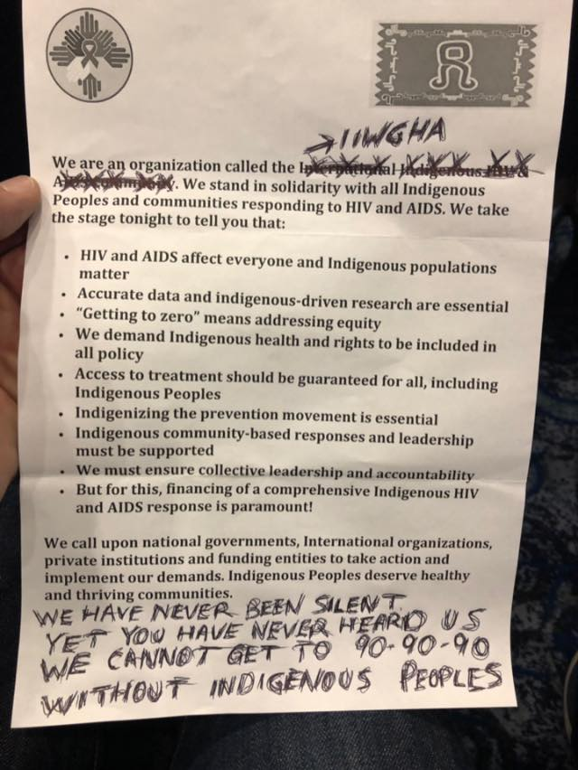
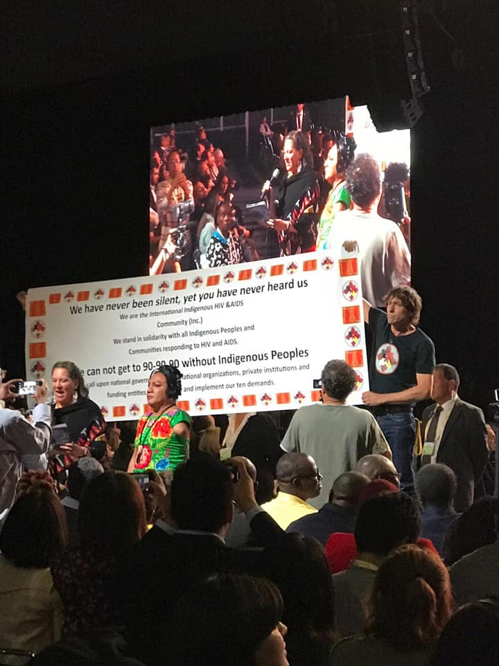

Slide 4
Indigenous Peoples of the World
Indigenous Peoples comprise 400 million people globally
4.4% of worlds’ population, located in 70 countries
> 5000 groups, 10% of the world’s poorest are Indigenous people
Most live in remote and/or isolated areas of the world
Over 50% live in China, India, Indonesia, Myanmar
Many communities tribes or clans comprise populations from a few to hundreds to thousands

Slide 5
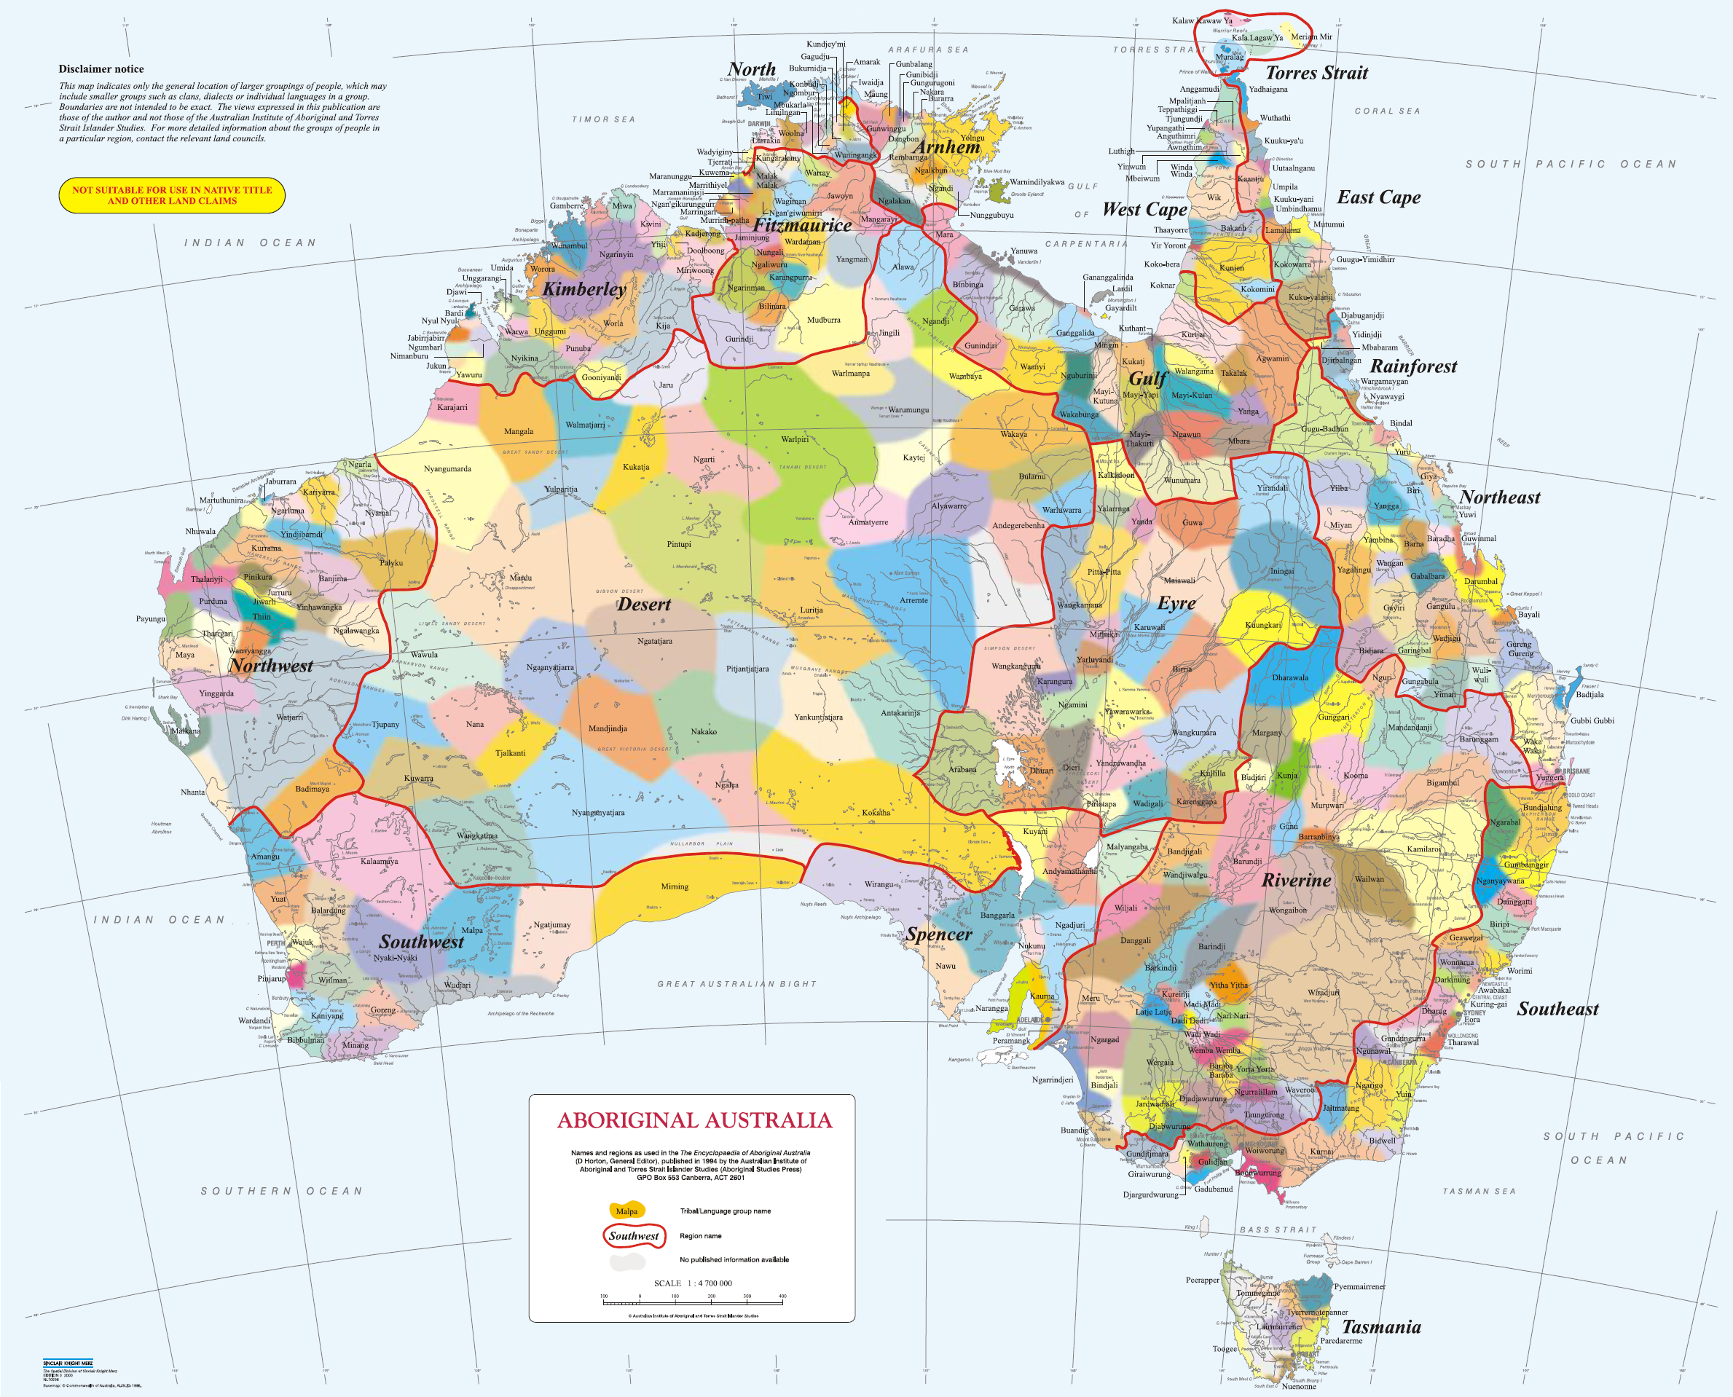

Slide 6
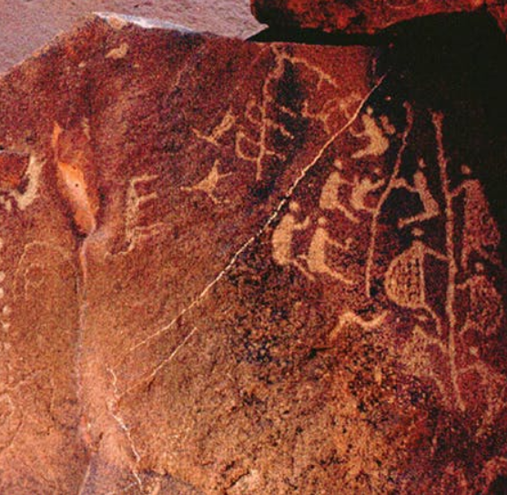
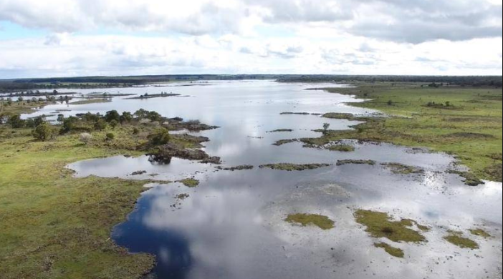
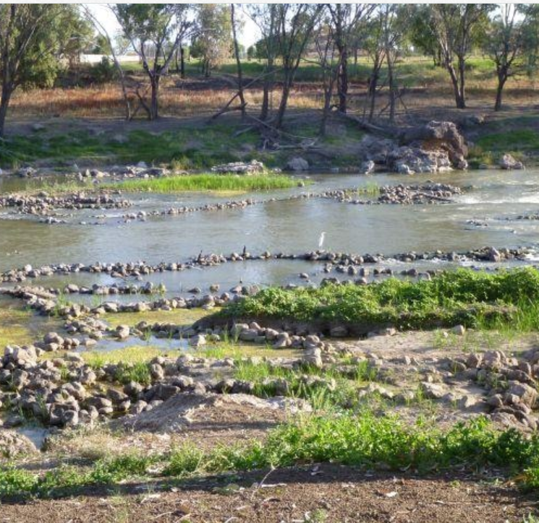
Worlds oldest living continuous culture

Slide 7
So who are Aboriginal and Torres Strait Islander people
Population 761,300 = 3% of the total population.
Heterogenous
More live in regional and remote Australia than in cities
Young population
Very disadvantaged population
Health outcomes much worse SMR 1.3 x non Indigenous population
Many efforts to reduce gaps in health

Slide 8
Area of residence, 2017, by Indigenous status
Source: Australian Bureau of Statistics 2017

Slide 9
HIV and Aboriginal and Torres Strait Islander People

Slide 10
Data and Aboriginal and Torres Strait Islander people
Australia benefits from a world class surveillance system to monitor HIV within the Country
Aboriginal and Torres Strait Islander people enumerated from 1992
Notification data for HIV is accurate and almost all HIV notifications in Australia are complete for Indigenous status
Gaps exist in key population denominators, clinical care, co-infections/morbidities, the role of underlying determinants of HIV

Slide 11
Reporting of Aboriginal and Torres Strait Islander status at notification, for selected sexually transmissible infections, 2017, by state or territory
Source: Australian National Notifiable Diseases Surveillance System

Slide 12
HIV notification rate per 100 000 Australian‑born population, 2008–2017, by Indigenous status
Source: State and territory health authorities; includes all states and territories

Slide 13
HIV notification exposure category, 2013–2017, by Indigenous status
.
Source: State and territory health authorities; includes all states and territories

Slide 14
Social and cultural determinants of HIV
Colonisation
Cultural continuity
Intergenerational trauma
Globalisation
Land & territory status
Discrimination, racism, stigma
Education
Income
Employment
Health Care
Social networks
Early Childhood development

Slide 15
How are we addressing gaps in data currently?

Slide 16
Constructing a HIV diagnosis and care continuum
Related to Aboriginal and Torres Strait Islander people
People living with HIV
People diagnosed with HIV
Proportion of undiagnosed infection
Estimate of mortality among people previously diagnosed with HIV
People retained in care
Proportion of People in care on ART
Proportion of people on ART with SVL
ECDC
ACCESS

Slide 17
THE ECDC HIV Modelling tool
The HIV modelling tool developed by European Centre for Prevention and Disease Control (ECDC)
With this tool you can estimate: • the number of people living with HIV, including those not yet diagnosed; • the annual number of new HIV infections; • the average time between infection and diagnosis; • the number of people in need of treatment according to CD4 cell counts
The goodness of fit for the model was suited to our epidemiology

Slide 18
Estimating number of Aboriginal and Torres Strait Islander people with HIV

Slide 19
HIV infections per year ECDC modelling

Slide 20
Estimate of undiagnosed infections

Slide 21
Mean time to diagnosis

Slide 22
Aboriginal and Torres Strait Islander HIV Diagnosis and Treatment Cascade 2018

Slide 23
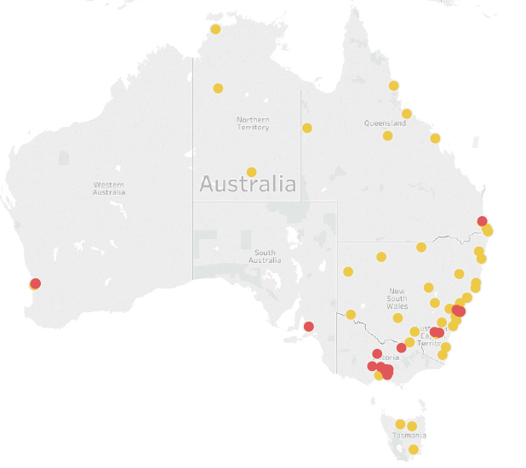
Proposed SAHMRI study
Developing the care component of the cascade
Aboriginal PLHIV cascade
Methods
Using extracted clinical data from
ACCESS Network
Comprising
57 sexual health clinics
34 General Practice clinics
6 hospitals

Slide 24
Definitions
In care
Having had any record of care in cascade year and one year prior (CD4 or VL)
Retained in care:
having had VL or CD4 in that year
On treatment
Treatment record (or supressed VL) in that year
VL suppression
Supressed: VL <200 in that year

Slide 25
Aboriginal and Torres Strait Islander HIV Diagnosis and Treatment Cascade 2018

Slide 26
HIV Diagnosis and care cascade 2015-2017

Slide 27
Estimating Indigenous MSM population
Estimate of Aboriginal & Torres Strait Islander GBM
Estimated by ABS (population plus same sex households), by jurisdiction, city vs other, range determined by self reported in multiple population surveys - PLWH, mortality
Result: range 3833-11807
Assume 40% high risk GBM eligible for PrEP= 1533- 4722
~430 enrolled in PrEP trials ## 9-28% of estimated eligible population

Slide 28
Summary
Good surveillance systems in place but gaps remain
HIV Increasing in Australia’s First Peoples, concurrent decreases among non Indigenous people
HIV exposure is different from non Indigenous people
Modelling shows around 11% of PLWH remain undiagnosed
Significant gaps in diagnosis and care cascade
More intense efforts are required to increase proportion of MSM on PrEP

Slide 29
Where are the gaps that warrant further investigation?
Qualitative research – PLWH perspective
Clinical care particularly for PLWH (gaps exist in cascade)
The role of determinants in access to care, risk
Socio- cultural determinants such as intersectional oppression (i.e. racism, sexism, homophobia, heteropatriarchy, classism, colonialism, etc).
Low uptake of PrEP
Key population denominator data (PWID, estimate of heterosexual at risk)
The use of HIV phylogenetics is being currently assessed to supplement surveillance systems (resistance transmission, subtypes)
Data linkage- notifications to medications (Pharmaceutical Benefits Scheme), health care access through (Medicare Benefits Scheme), hospitalisations, coinfections, mortality

Slide 30
Finally
Succeeding in closing the gaps in data required to end the epidemic in our population
In a population like ours ending HIV should be achieved first but we are behind
We need to change the way new biomedical interventions are rolled out to ensure populations most marginalised receive intense efforts up front

Slide 31
Thank you
A/Prof James Ward
Head Infectious Disease Research Aboriginal Health
SAHMRI
Email: james.ward@sahmri.com

